Slide 1
Fundraiser Training (K-8)
Notes:
2021-2022

Slide 2
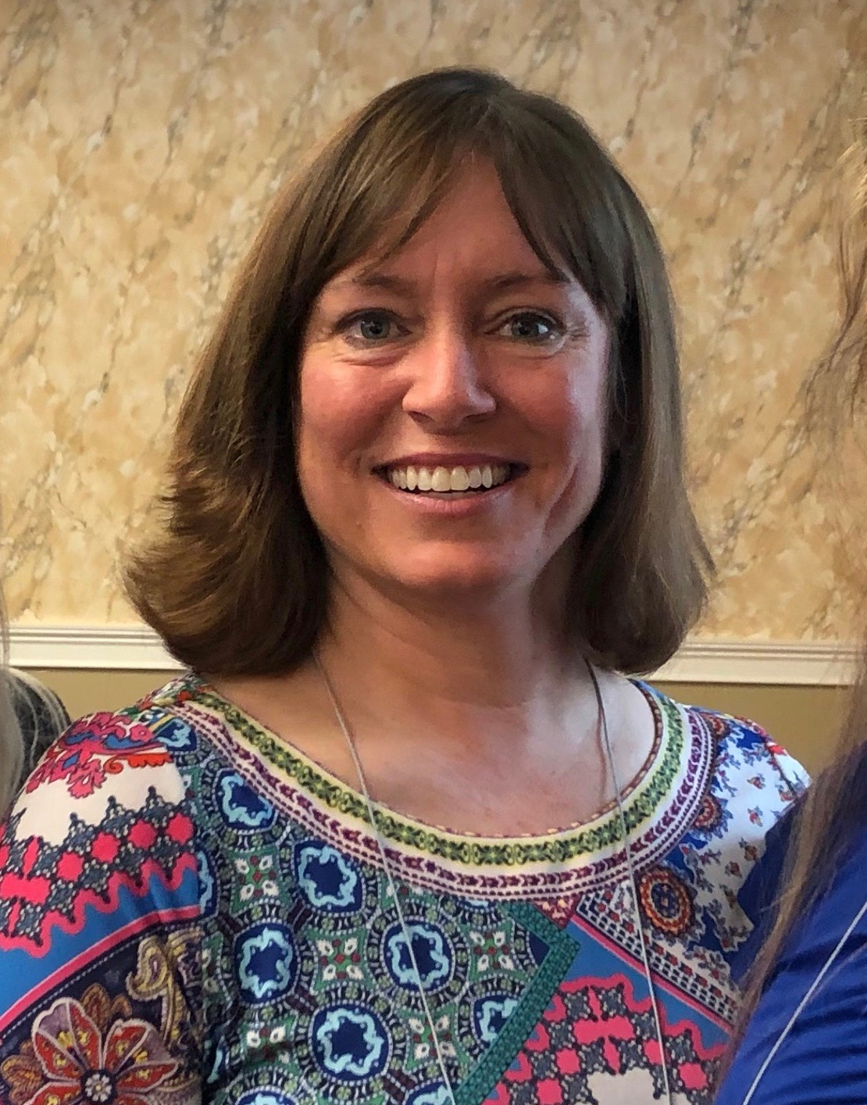
SFFC Foundation
The SFFC Foundation is a nonprofit organization based in Nashville, TN. Our current initiatives include the PFE Scholarship and Nourish Grants for individuals/families.
Administration Team
Ashley Beisiegel Jackie Downs
K-8 Program Officer 9-12 Program Officer
Office Number: (615) 675-0450

Slide 3
Origin Video

Slide 4
Your Commitments
Create a plan before the school year begins to fundraise 30% of PFE scholarship funds.
Secure donations for school’s portion (30%) of student scholarship.
Acknowledge your local donors.
Work with your coordinator to report fundraising activities and totals to PFE administration.

Slide 5
Create a Plan and Fundraise!
We recommend that you have your funds in-hand before the school year begins, but we know that events during the school year are often coordinated to raise funds for PFE.
We require that the funds raised for PFE be new funds, rather than a shifting of existing budget.
We recommend including the church, your community, and individuals (such as alumni or church members) in fundraising.
Your school may be asked to report what has been raised, periodically.

Slide 6
Fundraising Ideas
Here are some suggestions that we have seen work at other schools:
A special event like a talent show, dinner, or walkathon
Nuts or produce sales
Community or church yard sales
Silent auctions
Inviting alumni to give
Ask your church during participant testimony
Set up a special PFE booth at school fairs
Consider virtual fundraisers
We would love to hear from you about what other ideas work in your community!

Slide 7
Acknowledge Local Donors
If your school is blessed with a local donor who gives toward PFE scholarship funds, be sure to acknowledge the donor whenever possible.
Some ideas are:
Thank you letters or videos from your students and their mentors.
Share testimonials and positive, life-changing stories that happen, in part, because of the donation.
Publicly thank your donor at awards chapel, board meetings, or PFE functions IF your donor does not mind being publicly acknowledged.

Slide 8
Impact Video

